Slide 1

There are other servers available like Tomcat, Node, Nginx, Appweb, etc.
Apache is a very popular web server
A web server uses certain software that allows a browser to send and receive data from a server
There are different types of servers that do different things
Mail Servers
Web Servers
File Servers
Database Servers

Slide 2
Important: a web server is not a programming language
You don’t write Apache code
The Apache server runs by using configuration files
Configuration files are just plain text files where directives (rules) are added to the file that control Apache’s behaviour
In its default state, an Apache server listens to the IP addresses identified in its config file (HTTPd.conf)

Slide 3
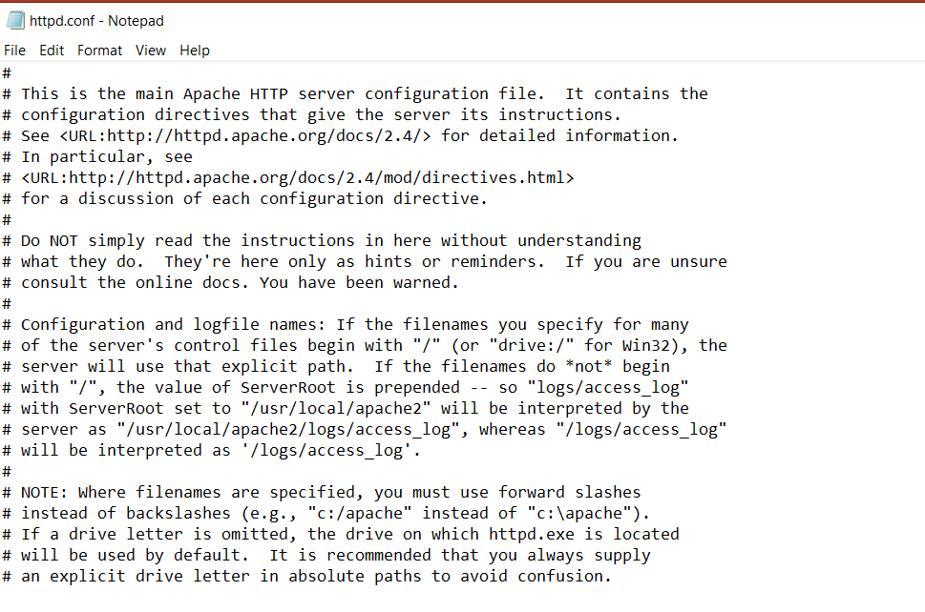
Important: a web server is not a programming language
You don’t write Apache code
The Apache server runs by using configuration files
Configuration files are just plain text files where directives (rules) are added to the file that control Apache’s behaviour
In its default state, an Apache server listens to the IP addresses identified in its config file (HTTPd.conf)

Slide 4
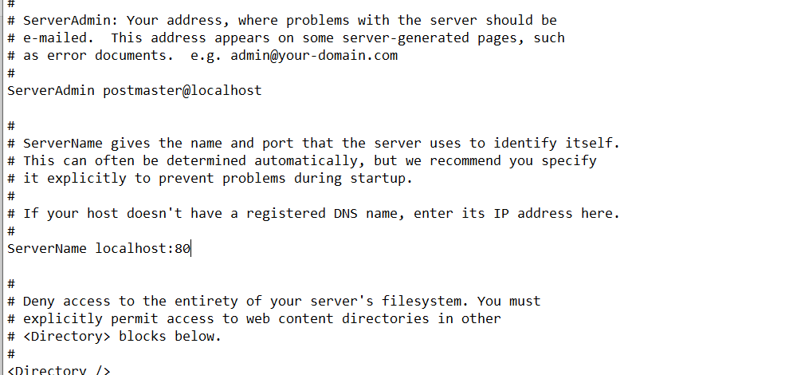
Important: a web server is not a programming language
You don’t write Apache code
The Apache server runs by using configuration files
Configuration files are just plain text files where directives (rules) are added to the file that control Apache’s behaviour
In its default state, an Apache server listens to the IP addresses identified in its config file (HTTPd.conf)

Slide 5
Apache can be installed on most computer systems
Regardless of your web hosting company used, a live website will typically have an htdocs directory – this is the Apache folder
htdocs is the main default Apache web server folder
Since files and sub-folders inside htdocs are available to the public, correct handling of file permissions is important

Slide 6
Good news - Apache can understand different programming languages
You can tell Apache that any file that ends with .php should be interpreted as PHP
Apache will then launch the PHP interpreter to read the file and process it into an HTML page
Let’s see Apache in action

